Slide 1
AI Document Layout Analysis
Team Name: UIT Departure
Cinnamon AI Marathon

Slide 2
Content
About us
Overview
Dataset
Approach to problem solving

Slide 3
I. About us
Team Name: UIT Departure
Team Menbers: Vuong Ho Ngoc – Computer Science
Loc Vo Van – Computer Science
Ngan Le Thi Phuong - Software Engineer
Phuc Hoang Ngo - Software Engineer

Slide 4
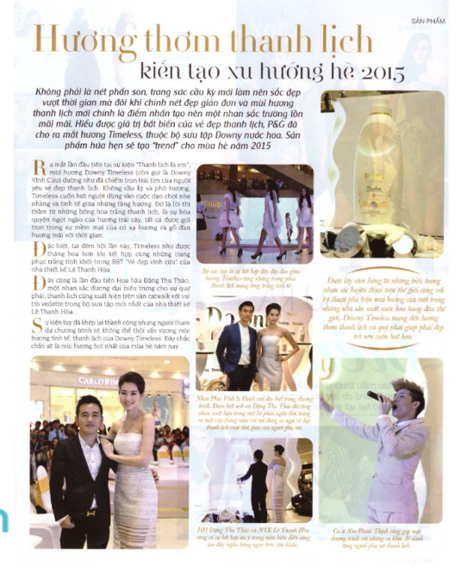
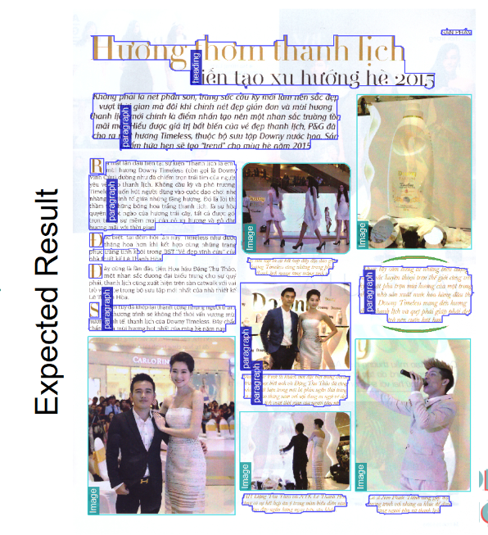
II. Overview
Designing a system/algorithm to analyze the layout of Vietnamese document image
(respect to magazine).
Ideas:
Sliding Window based on clustering algorithm
Sliding Window based on Selective Search window
FCN for semantic segmentation

Slide 5
III. Dataset
The contest has provided 200 images and Our team has collected data on the internet for 405 images
Training set: 425 images
Public test set: 120 images
Private test set: 60 images
Training/Evaluation/Test 70:20:10

Slide 6
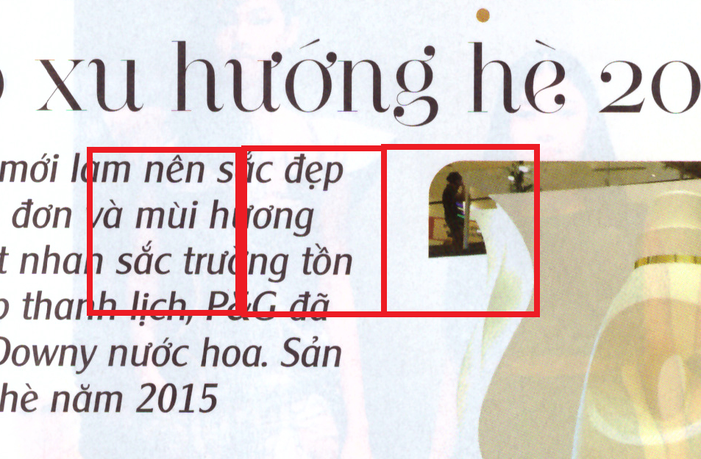
IV. Approach to problem solving
I. Sliding window
1.Generate data
Sliding window with weight x height 140 x 140
Label: (2000 images/label)
• 0: Image
• 1: Text
• 2 Heading
• 3: Background
Training/Evaluation 80:20 Sliding windown

Slide 7
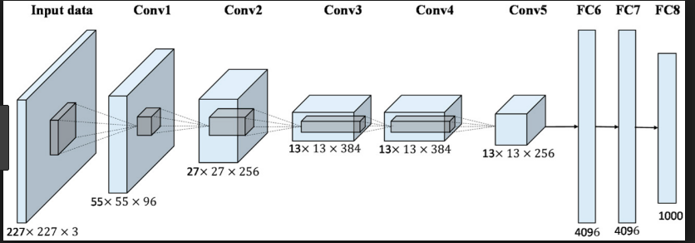
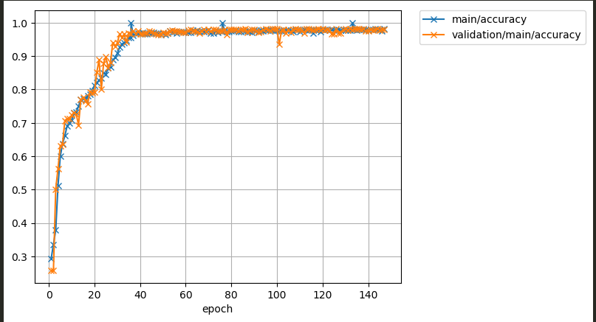
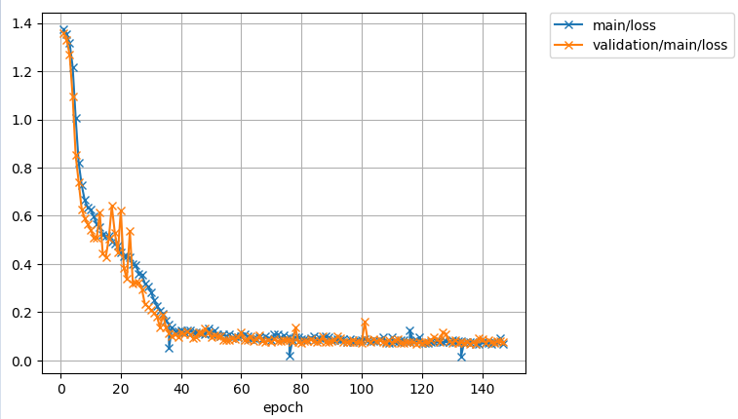
2 .Result Model using approach sliding window
Optimizer MomentumSGD
(lr=0.0001, momentum=0.9)
3 hour/epoch
All total time: 4 day
Model : Alexnet , Lenet5
Accuracy
Loss

Slide 8
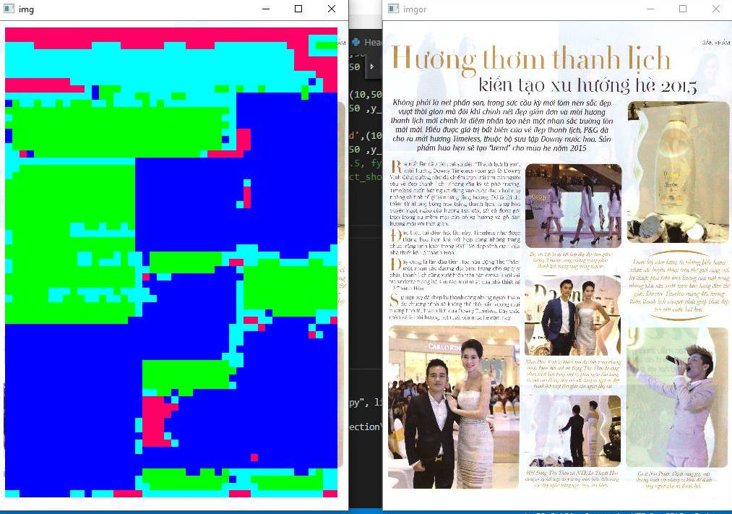
3. Predict by Sliding Window 140x140 with stride 50 pixel
One problem is that when using this method, we do not know what the suitable sizes of windows are. In this sample, the chosen size is 140 x 140 with 50-pixel pre step.
Predicting for a image is time-consuming
Another problem is that when using Sliding Window technique in the case of which windows position on 2 objects, predicting would make some unexpected mistakes.
Problem ?

Slide 9
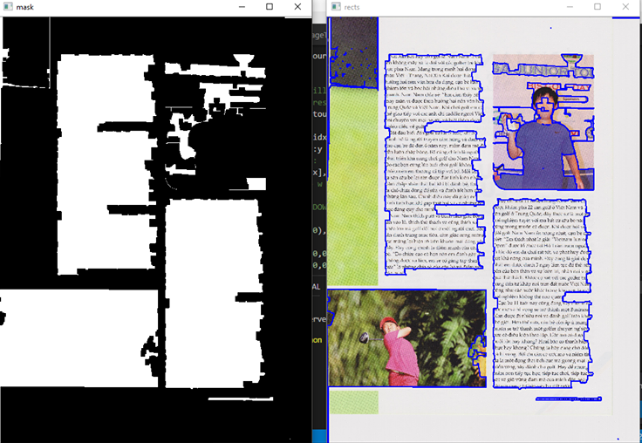
4. How to fix problem
The solution for this case is making a binary image form the original one. The process is completed after considering some attributes such as characteristics of colors, the viewpoint of images. As the results, the predicting for some particles is not necessary, the accuracy increases and it takes less needed time.
However, binarizing process is not always accurate, the result are not good as expected.

Slide 10
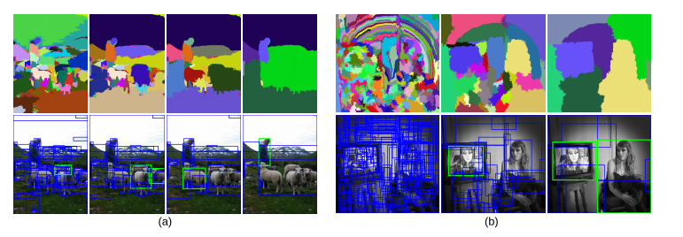
5. Selective search for object recognition
Another method, which is selective search for object recognition, is implemented to find out main -object-containing windows, which will be material for predicting process. After some test, this method does not give much more better results, because the inaccuracies of two new processed model make the rate of correctness lower.

Slide 11
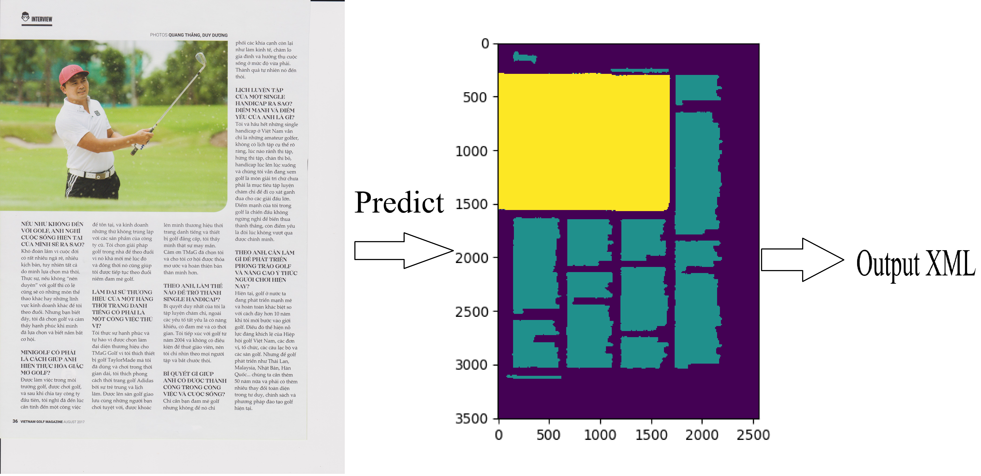
ii. Semantic Segmentation using Deep learning
In this case, we choose Fully Convolutional Network-Based Semantic Segmentation method, which improves the negative points of the above method. The results are less needed time and increased accuracy

Slide 12
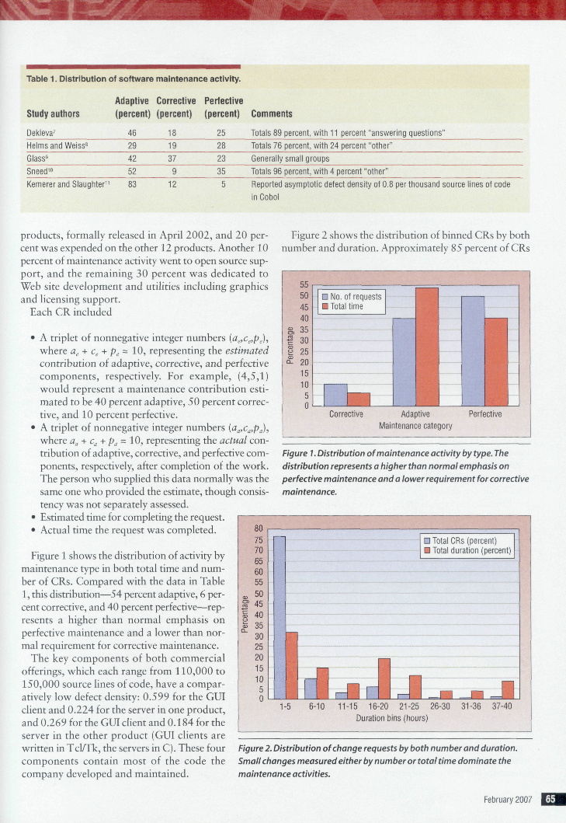


Fully Convolutional Networks for Semantic Segmentation
Data
From file XML, my team create data (input arbitrary-sized images)
Label: 0 Background
1 TextRegion
2 ImageRegion
3 TableRegion
4 ChartRegion
Training:
Learning rate: 0.00001
Loss: 0.04
All time training: 10day
Using gpu nvidia tesla k80
Origin Images
View Label
Label for AI

Slide 13
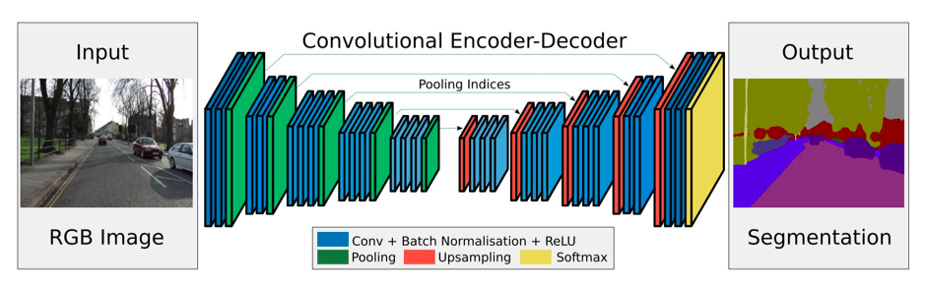
Fully Convolutional Networks architecture
A general semantic segmentation architecture can be broadly thought of as an encoder network followed by a decoder network:
The encoder is usually is a pre-trained classification network like VGG/ResNet followed by a decoder network. A pre-trained VGG16 is used as an encoder
The task of the decoder is to semantically project the discriminative features (lower resolution) learnt by the encoder onto the pixel space (higher resolution) to get a dense classification
The fully connected layers of VGG16 is converted to fully convolutional layers, using 1x1 convolution. This process produces a class presence heat map in low resolution.

Slide 14
Thank you for your attention!

